Slide 1
Introduction
ECC 702 Mobile Communication
Venkataramanan V
EXTC Department
D.J. Sanghvi College of Engineering, Mumbai.

Slide 2
Course Details
Staff: V.Venkataramanan
Email : venkataramanan.v@djsce.ac.in
rvvenkat.mtech@gmail.com

Slide 3
Recommended Textbooks
1. Theodore S. Rappaport , ―Wireless Communications, Prentice Hall of India, PTR publication
2. Andreas Molisch , ―Wireless Communications, Wiley, Student second Edition.

Slide 4
Recommended Textbooks
3. Vijay Garg , ―Wireless Network Evolution 2G-3G, Pearson Education.
4. Young Kyun Kim and Ramjee Prasad, ―4 G Roadmap and Emerging Communication Technologies ―, Artech house.:

Slide 5
Recommended Textbooks
5. Raj Pandya , ―Mobile And Personal Communications Systems And Services, Prentice hall.
6. Singhal , ―Wireless Communication, TMH
7. C.Y Lee , ―Mobile Communication, Wiley
8. Upena Dalal ―Wireless and Mobile Communications, Oxford university Press.

Slide 6
Outline
Introduction
The concept of Mobile radio propagation, cellular system design.
To understand mobile technologies like GSM and CDMA
To know the mobile communication evolution of 2G, 3G and 3 GPP in detail
To have overview of Emerging technologies for 4 G standards.

Slide 7
Outline
Fundamentals of Mobile Communication

Slide 8
Outline
Mobile Radio Propagation

Slide 9
Outline
2G Technologies

Slide 10
Outline
3G Technology

Slide 11
Outline
3 GPP LTE

Slide 12
Outline
Advanced techniques for 4G deployment

Slide 13
What is Wireless and Mobile Communication?

Slide 14
Wireless Communication
Transmitting voice and data using electromagnetic waves in open space
Electromagnetic waves
Travel at speed of light (c = 3x10⁸ m/s)
Has a frequency (f) and wavelength (λ)
c = f x λ
Higher frequency means higher energy photons
The higher the energy photon the more penetrating is the radiation

Slide 15
Electromagnetic Spectrum
10⁴
10²
10⁰
10⁻²
10⁻⁴
10⁻⁶
10⁻⁸
10⁻¹⁰
10⁻¹²
10⁻¹⁴
10⁻¹⁶
Radio
Spectrum
Micro wave
IR
UV
X-Rays
Cosmic
Rays
10⁴
10⁶
10⁸
10¹⁰
10¹²
10¹⁴
10¹⁶
10¹⁸
10²⁰
10²²
10²⁴
1MHz ==100m 100MHz ==1m
10GHz ==1cm
Visible light
< 30 KHz VLF 30-300KHz LF
300KHz – 3MHz MF 3 MHz – 30MHz HF 30MHz – 300MHz VHF
300 MHz – 3GHz UHF
3-30GHz SHF
> 30 GHz EHF

Slide 16
Wavelength of Some Technologies
GSM Phones:
frequency ~= 900 Mhz
wavelength ~= 33cm
PCS Phones
frequency ~= 1.8 Ghz
wavelength ~= 17.5 cm
Bluetooth:
frequency ~= 2.4Gz
wavelength ~= 12.5cm

Slide 17
Frequency Carries/Channels
The information from sender to receiver is carrier over a well defined frequency band.
This is called a channel
Each channel has a fixed frequency bandwidth (in KHz) and Capacity (bit-rate)
Different frequency bands (channels) can be used to transmit information in parallel and independently.

Slide 18
Simplex Communication
Normally, on a channel, a station can transmit only in one way.
This is called simplex transmision
To enable two-way communication (called full-duplex communication)
We can use Frequency Division Multiplexing
We can use Time Division Multiplexing

Slide 19
Duplex Communication - FDD
FDD: Frequency Division Duplex
Base Station
B
Mobile Terminal
M
Forward Channel
Reverse Channel
Forward Channel and Reverse Channel use different frequency
bands

Slide 20
Duplex Communication - TDD
TDD: Time Division Duplex
Base Station
B
Mobile Terminal
M
M
B
M
B
M
B
A singe frequency channel is used. The channel is divided into time slots. Mobile station and base station transmits on the time slots alternately.
Time division duplex (TDD) refers to duplex communication links where uplink is separated from downlink by the allocation of different time slots in the same frequency band. It is a transmission scheme that allows asymmetric flow for uplink and downlink data transmission.

Slide 21
What is Mobility
Initially Internet and Telephone Networks is designed assuming the user terminals are static
No change of location during a call/connection
A user terminals accesses the network always from a fixed location
Mobility and portability
Portability means changing point of attachment to the network offline
Mobility means changing point of attachment to the network online

Slide 22
Degrees of Mobility
Walking Users
Low speed
Small roaming area
Usually uses high-bandwith/low-latency access
Vehicles
High speeds
Large roaming area
Usually uses low-bandwidth/high-latency access
Uses sophisticated terminal equipment (cell phones)

Slide 23
The Need for Wireless/Mobile Networking
Demand for Ubiquitous Computing
Anywhere, anytime computing and communication
You don’t have to go to the lab to check your email
Pushing the computers more into background
Focus on the task and life, not on the computer
Use computers seamlessly to help you and to make your life more easier.
Computers should be location aware
Adapt to the current location, discover services

Slide 24
Some Example Applications of Ubiquitous Computing
You walk into your office and your computer automatically authenticates you through your active badge and logs you into the Unix system
You go to a foreign building and your PDA automatically discovers the closest public printer where you can print your schedule and give to your friend

Slide 25
How to realize Ubiquitous Computing
Small and different size computing and communication devices
Tabs, pads, boards
PDAs, Handhelds, Laptops, Cell-phones
A communication network to support this
Anywhere, anytime access
Seamless, wireless and mobile access
Need for Personal Communication Services (PCS)
Ubiquitous Applications
New software

Slide 26
Wireless System Definitions
Mobile Station
A station in the cellular radio service intended for use while in motion at unspecified locations. They can be either hand-held personal units (portables) or installed on vehicles (mobiles)
Base station
A fixed station in a mobile radio system used for radio communication with the mobile stations. Base stations are located at the center or edge of a coverage region. They consists of radio channels and transmitter and receiver antennas mounted on top of a tower.

Slide 27
Wireless System Definitions
Mobile Switching Center
Switching center which coordinates the routing of calls in a large service area. In a cellular radio system, the MSC connections the cellular base stations and the mobiles to the PSTN (telephone network). It is also called Mobile Telephone Switching Office (MTSO)
Subscriber
A user who pays subscription charges for using a mobile communication system
Transceiver
A device capable of simultaneously transmitting and receiving radio signals

Slide 28
Wireless System Definitions
Control Channel
Radio channel used for transmission of call setup, call request, call initiation and other beacon and control purposes.
Forward Channel
Radio channel used for transmission of information from the base station to the mobile
Reverse Channel
Radio channel used for transmission of information from mobile to base station

Slide 29
Wireless System Definitions
Simplex Systems
Communication systems which provide only one-way communication
Half Duplex Systems
Communication Systems which allow two-way communication by using the same radio channel for both transmission and reception. At any given time, the user can either transmit or receive information.
Full Duplex Systems
Communication systems which allow simultaneous two-way communication. Transmission and reception is typically on two different channels (FDD).

Slide 30
Wireless System Definitions
Handoff
The process of transferring a mobile station from one channel or base station to an other.
Roamer
A mobile station which operates in a service area (market) other than that from which service has been subscribed.
Page
A brief message which is broadcast over the entire service area, usually in simulcast fashion by many base stations at the same time.

Slide 31
Cordless Telephones
PSTN
Telephone
Network
Cordless
Phone
Base unit

Slide 32
Cordless Telephones
Characterized by
Low mobility (in terms of range and speed)
Low power consumption
Two-way tetherless (wireless) voice communication
High circuit quality
Low cost equipment, small form factor and long talk-time
No handoffs between base units
Appeared as analog devices
Digital devices appeared later with CT2, DECT standards in Europe and ISM band technologies in USA

Slide 33
Cordless Telephones
Usage
At homes
At public places where cordless phone base units are available
Design Choices
Few users per MHz
Few users per base unit
Many base units are connected to only one handset
Large number of base units per usage area
Short transmission range

Slide 34
Cordless Phone
Some more features
32 Kb/s adaptive differential pulse code modulation (ADPCM) digital speech encoding
Tx power <= 10 mW
Low-complexity radio signal processing
No forward error correction (FEC) or whatsoever.
Low transmission delay < 50ms
Simple Frequency Shift Modulation (FSK)
Time Division Duplex (TDD)

Slide 35
Cellular Telephony
Characterized by
High mobility provision
Wide-range
Two-way tetherless voice communication
Handoff and roaming support
Integrated with sophisticated public switched telephone network (PSTN)
High transmit power requires at the handsets (~2W)

Slide 36

Cellular Telephony - Architecture

Slide 37
Cellular Telephony Systems
Mobile users and handsets
Very complex circuitry and design
Base stations
Provides gateway functionality between wireless and wireline links
~1 million dollar
Mobile switching centers
Connect cellular system to the terrestrial telephone network

Slide 38
Paging Systems
One-way communication (SX)
Send short message to mobile unit (pager)
Wide area coverage
Page broadcast from many base stations simultaneously to remote units
no information as to user location
Reliable communication everywhere (need good Signal to Noise performance)

Slide 39
Paging Systems
Requires large Tx power and low data rate
(~ 2-8 kbps)
Noise has less of an effect when the data rate is lower.
Coverage needed even inside buildings w/ 20-30 dB signal attenuation
Needs an extensive network of transmitters to transmit the signal everywhere

Slide 40
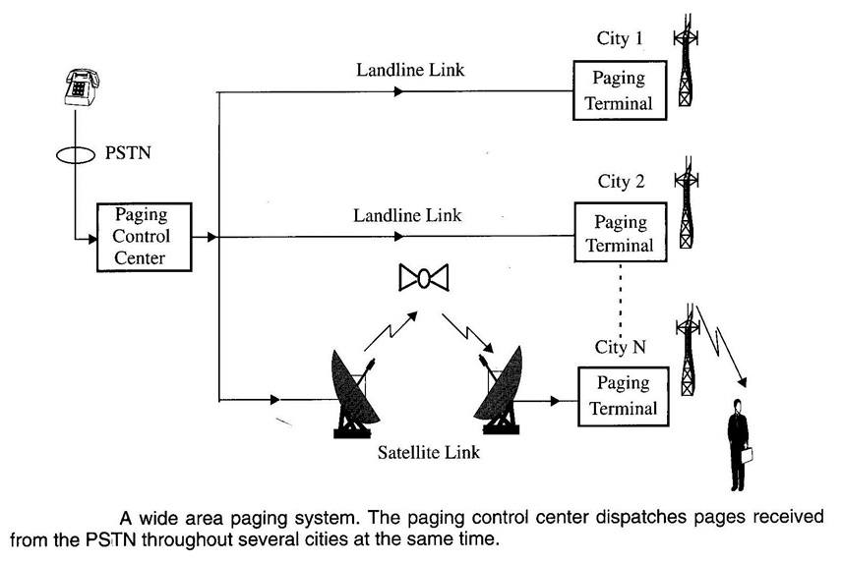
Paging Systems

Slide 41
Cellular Phone Call Timing
Mobile Identification Number (MIN) is the subscriber's telephone number
Electronic Serial Number (ESN) is device identifier.
Station Class Mark (SCM) identifies the class of the device, based on its maximum transmit power level.

Slide 42
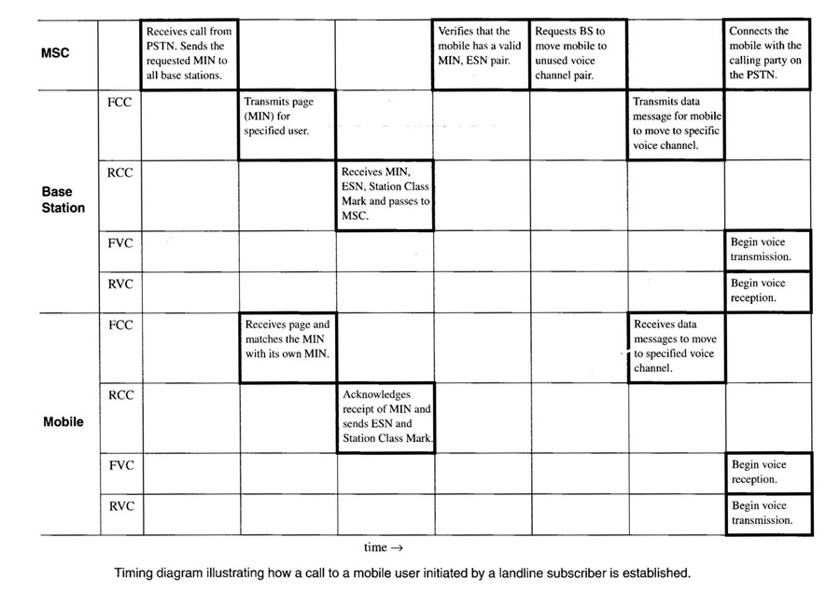
How a Cellular Telephone Call is Made

Slide 43
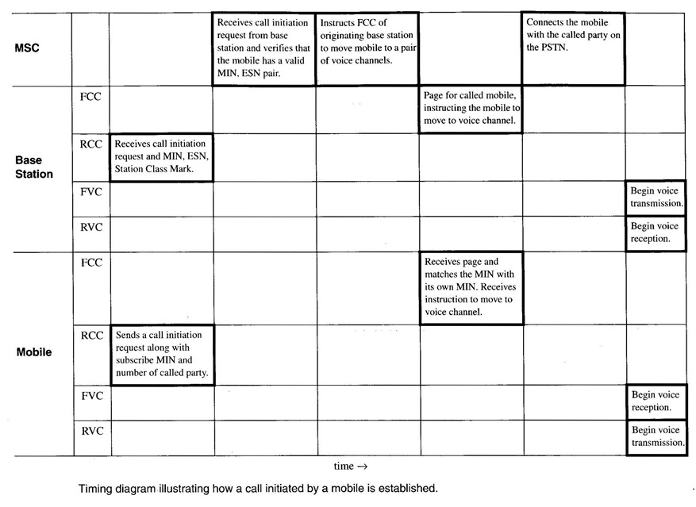
How a Cellular Telephone Call is Made

Slide 44
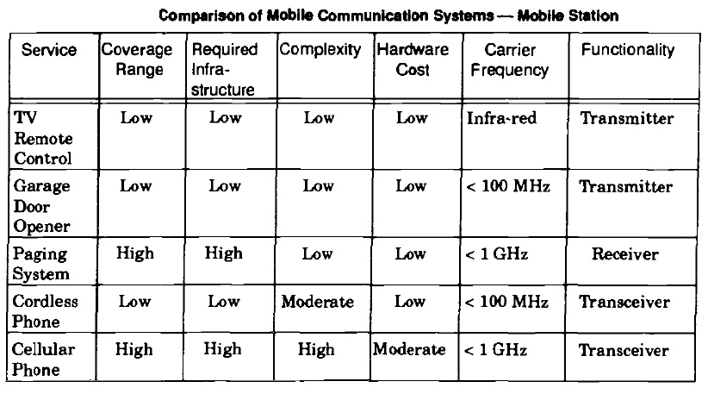
Comparison of Common Mobile Radio Systems

Slide 45
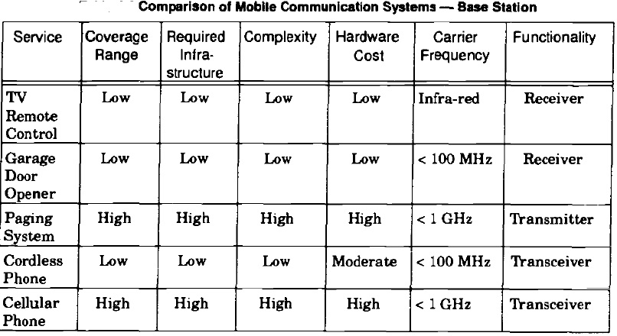
Comparison of Common Mobile Radio Systems

Slide 46
Cellular Networks
First Generation
Analog Systems
Analog Modulation, mostly FM
AMPS
Voice Traffic
FDMA/FDD multiple access
Second Generation (2G)
Digital Systems
Digital Modulation
Voice Traffic
TDMA/FDD and CDMA/FDD multiple access
2.5G
Digital Systems
Voice + Low-datarate Data
Third Generation
Digital
Voice + High-datarate Data
Multimedia Transmission also

Slide 47
2G and Data
2G is developed for voice communications
You can send data over 2G channels by using modem
Provides adat rates in the order of ~14.4 Kbps
Increased data rates are requires for internet application
This requires evolution towards new systems: 2.5 G

Slide 48
2.5 Technologies
Evolution of TDMA Systems
HSCSD for 2.5G GSM
Up to 57.6 Kbps data-rate
GPRS for GSM and IS-136
Up to 171.2 Kbps data-rate
EDGE for 2.5G GSM and IS-136
Up to 384 Kbps data-rate
Evolution of CDMA Systems
IS-95B
Up to 64 Kbps

Slide 49
3G Systems
Goals
Voice and Data Transmission
Simultanous voice and data access
Multi-megabit Internet access
Interactive web sessions
Voice-activated calls
Multimedia Content
Live music

Slide 50
3G Systems
Evolution of Systems
CDMA sysystem evaolved to CDMA2000
CDMA2000-1xRTT: Upto 307 Kbps
CDMA2000-1xEV:
CDMA2000-1xEVDO: upto 2.4 Mbps
CDMA2000-1xEVDV: 144 Kbps datarate
GSM, IS-136 and PDC evolved to W-CDMA (Wideband CDMA) (also called UMTS)
Up to 2.048 Mbps data-rates
Future systems 8Mbps
Expected to be fully deployed by 2010-2015
New spectrum is allocated for these technologies

Slide 51
Upgrade Paths for 2G Technologies
2G
IS-95
GSM
IS-136 PDC
GPRS
2.5G
IS-95B
HSCSD
EDGE
3G
cdma200-1xRTT
W-CDMA
EDGE
cdma2000-1xEV,DV,DO
TD-SCDMA
cdma200-3xRTT

Slide 52
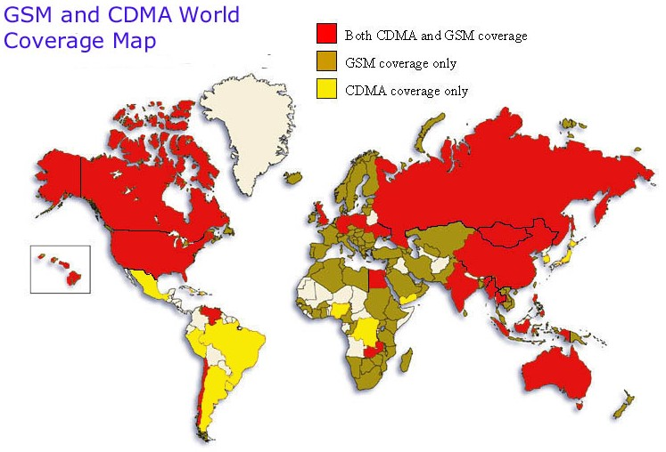
GSM and CDMA Coverage Map Worldwide

Slide 53
Multiple Access
Narrowband Systems
Narrowband systems support low-bit-rate transmission;
Systems operating with channels substantially narrower than the coherence bandwidth are known as narrowband system;
In narrowband systems, all the components of signals are equally influenced by multipath propagation;
Narrowband systems are affected by selective fading.

Slide 54
Multiple Access
Wideband Systems
wideband systems support high-bit-rate transmission;
Wideband systems operate with channels substantially wider than the coherence bandwidth;
In wideband systems, the various frequency components of the signal may be differently affected by fading.

Slide 55
Multiple Access
Wireless networks are multiuser systems in which information is conveyed by means of radio waves.
In a multiuser environment, access coordination can be accomplished via several mechanisms:
by insulating the various signals sharing the same access medium;

Slide 56
Multiple Access
by allowing the signals to contend for the access;
or by combining these two approaches.
The choice for the appropriate scheme must take into account a number of factors, such as:
type of traffic under consideration;
available technology;
cost and complexity

Slide 57
Multiple Access
Access coordination may be carried out in different domains:
frequency domain
time domain
code domain
space domain.
Four main multiple access technologies are used by the wireless networks:
frequency division multiple access (FDMA)
time division multiple access (TDMA)
code division multiple access (CDMA)
space division multiple access (SDMA).

Slide 58
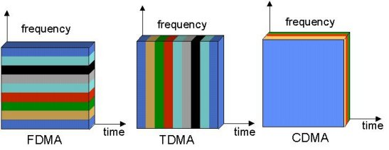
Multiple Access

Slide 59
Multiple Access (International Cocktail Party)
FDMA – Large room divided up into small rooms. Each pair of people takes turns speaking.
TDMA – Large room divided up into small rooms. Three pairs of people per room, however, each pair gets 20 seconds to speak.
CDMA – No small rooms. Everyone is speaking in different languages. If voice volume is minimized, the number of people is maximized.

Slide 60
General Specification of TDMA
Rx: 869-894MHz Tx: 824-849MHz
832 Channels spaced 30kHz apart (3 users/channel)
DQPSK modulation scheme
48.6kbps bit rate
Interim Standard (IS) – 54
Digital AMPS (Advanced Mobile Phone System)
Uses Time Division Duplexing (TDD) usually

Slide 61
TDMA Operation
Efficiency of TDMA frame:

Slide 62
Advantages of TDMA
Flexible bit rate
No frequency guard band required
No need for precise narrowband filters
Easy for mobile or base stations to initiate and execute hands off
Extended battery life
TDMA installations offer savings in base station equipment, space and maintenance
The most cost-effective technology for upgrading a current analog system to digital

Slide 63
Disadvantages to using TDMA
Requires network-wide timing synchronization
Requires signal processing fro matched filtering and correlation detection
Demands high peak power on uplink in transient mode
Multipath distortion

Slide 64
TDMA Frame Structure
Preamble | Information message | Trail Bits
Slot 1 | Slot 2 |  | Slot N
Trail Bit | Sync Bit | Information Bit | Guard Bits

Slide 65
FDMA Operation
Number of FDMA Channels
In the U.S. each cellular carrier is allocated 416 channels where:

Slide 66
General Specification of FDMA
Rx: 869-894MHz Tx: 824-849MHz
832 Channels spaced 30kHz apart (3 users/channel)
DQPSK modulation scheme
48.6kbps bit rate
Used in analog cellular phone systems (i.e. AMPS)
Uses Frequency Division Duplexing (FDD)
ISI (Inter symbol Interference) is low

Slide 67
Advantages of FDMA
If channel is not in use, it sits idle
Channel bandwidth is relatively narrow (30kHz)
Simple algorithmically, and from a hardware standpoint
Fairly efficient when the number of stations is small and the traffic is uniformly constant
Capacity increase can be obtained by reducing the information bit rate and using efficient digital code
No need for network timing
No restriction regarding the type of baseband or type of modulation

Slide 68
Interference
Co Channel Interference: Crosstalk from two different radio transmitters using the same frequency.
Adjacent-channel interference : Interference caused by extraneous power from a signal in an adjacent channel.
Inter symbol Interference : Reflected Signal with Smaller Amplitudes

Slide 69
Disadvantages to using FDMA
The presence of guard bands
Requires right RF filtering to minimize adjacent channel interference
Maximum bit rate per channel is fixed
Small inhibiting flexibility in bit rate capability
Does not differ significantly from analog system

Slide 70
General Specification of CDMA
Rx: 869-894MHz Tx: 824-849MHz
20 Channels spaced 1250kHz apart (798 users/channel)
QPSK/(Offset) OQPSK modulation scheme
1.2288Mbps bit rate
IS-95 standard
Operates at both 800 and 1900 MHz frequency bands

Slide 71
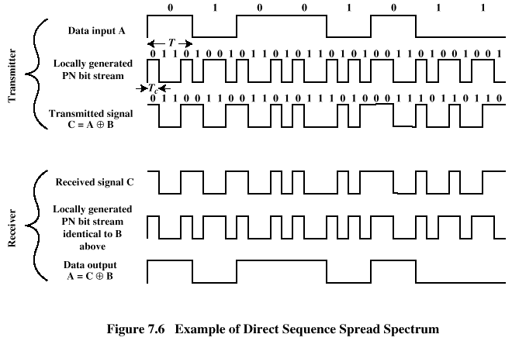
CDMA Operation
Spread Spectrum Multiple Access Technologies

Slide 72
Advantages of CDMA
Many users of CDMA use the same frequency, TDD or FDD may be used
Multipath fading may be substantially reduced because of large signal bandwidth
No absolute limit on the number of users
Easy addition of more users
Impossible for hackers to decipher the code sent
Better signal quality
No sense of handoff when changing cells

Slide 73
Disadvantages to using CDMA
As the number of users increases, the overall quality of service decreases
Self-jamming
Near- Far- problem arises (The near-far problem is a condition in which a receiver captures a strong signal and thereby makes it impossible for the receiver to detect a weaker signal.)

Slide 74
Hybrid Spread Spectrum Techniques
Hybrid combinations that provide certain advantages.
Hybrid FDMA CDMA (FCDMA) — This technique can be used as an alternative to the DS-CDMA techniques
The available wideband spectrum is divided into a number of sub spectras with smaller bandwidths.
Each of these smaller sub channels becomes a narrowband CDMA system having processing gain lower than the original CDMA system.

Slide 75
Hybrid Spread Spectrum Techniques
The required bandwidth need not be continuous and different users can be allotted different sub spectrum bandwidths.
The capacity of this FDMA/CDMA technique is calculated as the sum of the capacities of a system operating in the sub spectra.

Slide 76
Hybrid Direct Sequence / Frequency Hopped Multiple Access
Direct sequence modulated signal whose center frequency is made to hop periodically in a pseudorandom fashion

Slide 77
Hybrid Direct Sequence / Frequency Hopped Multiple Access
Direct sequence, frequency hopped systems - advantage - avoid the near-far effect.
However, frequency hopped CDMA systems are not adaptable to the soft handoff process. [Soft handoff refers to the overlapping of repeater coverage zones]
It is difficult to synchronize the frequency hopped base station receiver to the multiple hopped signals.

Slide 78
Time Division CDMA (TCDMA)
In a TCDMA (also called TDMA/ CDMA) system, different spreading codes are assigned to different cells.
Within each cell, only one user per cell is allotted a particular time slot.
At any time, only one CDMA user is transmitting in each cell.
When a handoff takes place, the spreading code of the user is changed to that of the new cell.

Slide 79
Time Division Frequency Hopping (TDFH)
This multiple access technique has an advantage in severe multipath or when severe co-channel interference occurs.
The subscriber can hop to a new frequency at the start of a new TDMA frame, thus avoiding a severe fade or erasure event on a particular channel.
This technique has been adopted for the GSM standard.
Hop : Move by jumping on one foot

Slide 80
Time Division Frequency Hopping (TDFH)
This scheme also avoids co-channel interference problems between neighboring cells
Two interfering base station transmitters are made to transmit on different frequencies at different times.
The use of TDFH can increase the capacity

Slide 81
Space Division Multiple Access (SDMA)
Space division multiple access (SDMA) controls the radiated energy for each user in space.
Sectorized antennas may be thought of as a primitive application of SDMA
A sector antenna is a type of directional microwave antenna with a sector-shaped radiation pattern.
Adaptive antennas used to simultaneously steer energy in the direction of many users

Slide 82
Space Division Multiple Access (SDMA)
Transmit power is limited by battery Consumption at the subscriber unit.
Adaptive antennas used at the base station promise to mitigate some of the problems on the reverse link.
The perfect adaptive antenna system is not feasible since it requires infinitely large antennas

Slide 83
Frequency Reuse
R
R
R
Cell
R
R
(a) Ideal cell
(b) Actual cell
(c) Different cell models

Slide 84
Choosing the Shape of a Cell
without overlap and with equal area, there are three sensible choices: a square; an equilateral triangle; and a hexagon.
A cell must be designed to serve the weakest mobiles within the footprint, and these are typically located at the edge of the cell.
The hexagon has the largest area of the three.
the hexagon closely approximates a circular radiation pattern which would occur for an Omni-directional base station antenna and free space propagation.

Slide 85
Frequency Reuse
consider a cellular system which has a total of S duplex channels available for use
If each cell is allocated a group of k channels
If the S channels are divided among N cells
the total number of available radio channels can be expressed as S=kN

Slide 86
Frequency Reuse
The N cells which collectively use the complete set of available frequencies is called a cluster.
If a cluster is replicated M times within the system, the total number of duplex channels, C, can be used as a measure of capacity and is given
C = MkN = MS

Slide 87
Signal Strength
Signal strength (in dB)
Cell i
Cell j
-60
-60
-70
-70
-80
-80
-90
-90
-100
-100
Select cell i on left of boundary
Select cell j on right of boundary
Ideal boundary

Slide 88
Signal Strength
Signal strength (in dB)
Cell i
Cell j
-60
-70
-60
-80
-70
-90
-80
-90
-100
-100
Signal strength contours indicating actual cell tiling. This happens because of terrain, presence of obstacles and signal attenuation in the atmosphere.

Slide 89
Handoff Region
Signal strength due to BS_{i}
Signal strength due to BS_{j}
P_{i}(x)
P_{j}(x)
E
P_{min}
BS_{i}
MS
BS_{j}
X₁
X₃
X₅
X_{th}
X₄
X₂
By looking at the variation of signal strength from either base station it is possible to decide on the optimum area where handoff can take place.

Slide 90
Cell Structure
F7
F2
F1
F2
F1
F2
F6
F1
F3
F1
F2
F3
F3
F3
F4
F5
F4
(a) Line Structure
(b) Plan Structure
Note: Fx is set of frequency, i.e., frequency group.

Slide 91
Frequency Reuse Structure
F7
F2
F7
F2
F6
F1
F3
F1
F6
F1
F3
F1
F5
F4
F7
F2
F5
F4
F7
F2
F6
F1
F3
F1
F6
F1
F3
F1
F5
F4
Reuse distance D
F5
F4
Fx: Set of frequency
7 cell reuse cluster

Slide 92
Reuse Distance
R
Cluster
For hexagonal cells, the reuse distance is given by
F7
F2
F6
F1
F3
F1
where R is cell radius and N is the reuse pattern (the cluster size or the number of cells per cluster).
F5
F4
F7
F2
F3
Reuse factor is
F6
F1
F1
Reuse distance D
F5
F4

Slide 93
Reuse Distance Contd
The cluster size or the number of cells per cluster is given by
j
where i and j are integers.
60º
i
N = 1, 3, 4, 7, 9, 12, 13, 16, 19, 21, 28, …, etc.
The popular value of N being 4 and 7.

Slide 94
Reuse Distance Contd
j=1
j=1
i=2
j direction
i=2
j=1
i=2
60°
i=2
i direction
j=1
1 2 3 … i
j=1
i=2
i=2
j=1
(a) Finding the center of an adjacent cluster using integers i and j (direction of i and j can be interchanged).
(b) Formation of a cluster for N = 7 with i=2 and j=1

Slide 95
Reuse Distance Contd
j=2
j=2
i=2
j=2
i=2
i=2
i=2
i=2
j=2
i=2
j=2
j=2
(c) A cluster with N =12 with i=2 and j=2

Slide 96
Frequency Reuse
Frequency Reuse is the core concept of cellular mobile radio
Users in different geographical areas (in different cells)
may simultaneously use the same frequency channel
Frequency reuse drastically increases user capacity and
spectrum efficiency
Frequency reuse causes mutual interference
(trade off between link quality and subscriber capacity)

Slide 97
Frequency Reuse
Honeycomb (hexagonal) cell structure
Cluster:
set of different frequencies used in group of cells
Cluster is repeated by linear shift
i
steps along one direction
j
steps in the other direction

Slide 98
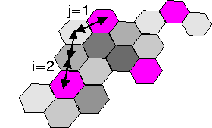
Frequency Reuse
Distance between cell centers
=
3
× Cell Radius
Reuse distance
distance between the centers of two co-channel cells
=
2
2
π
+
+
2ij
cos
3
R
i
j
R
u
3
where
R
is Cell Radius
R
is Reuse Distance
u
π
and
cos(
/3) = 1/2

Slide 99
Frequency Reuse
Radius of a cluster
2
2
R
i
+
j
+
ij
R
=
u
=
R
c
3
3

Slide 100
Frequency Reuse
We have seen
R
=
R
3C
u
and also
=
2
2
+
+
ij
3
R
i
j
R
u
Thus:
C
2
2
=
i
+
j
+
ij
with integer
i
and
j
.

Slide 101
Handoff Strategies
“When a mobile moves into a different cell while a conversation is in progress, MSC transfers the call to a new channel belonging to the new base station”. (Hard handoff)
In modern wireless systems, there may be no change in the actual channel; only the base station changes (Soft Hand off).
Mobile Switching Center needs to:
Identify the new base station
Allocate new Voice and Control channels associated with the new base station.

Slide 102

Desired Behavior:
Prioritize Hand off to new call initiation
Successful transfer of call
Hand off should be as infrequent as possible
Hand off should be imperceptible (very slight)
Hand off Threshold Power Level:
There is a minimum power level of the signal at BS for acceptable voice quality. (-90 to –100 dBm).
Hand off Threshold is defined D dBm above this level, so that the system has time to process hand off.
102

Slide 103
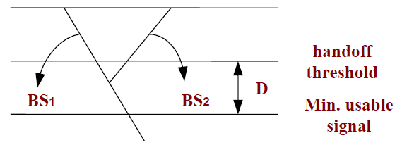
Margin D needs to be neither too small, nor too large
D too small → too short time to perform handoff, The call may be dropped in the meanwhile.
D too large → unnecessary handoff burden. Hand off becomes more frequent, and occurs even when Power is at the acceptable level.
Call will be dropped if
D is too small,
Delay in MSC processing because of:
High Traffic hours, New channel not available

Slide 104
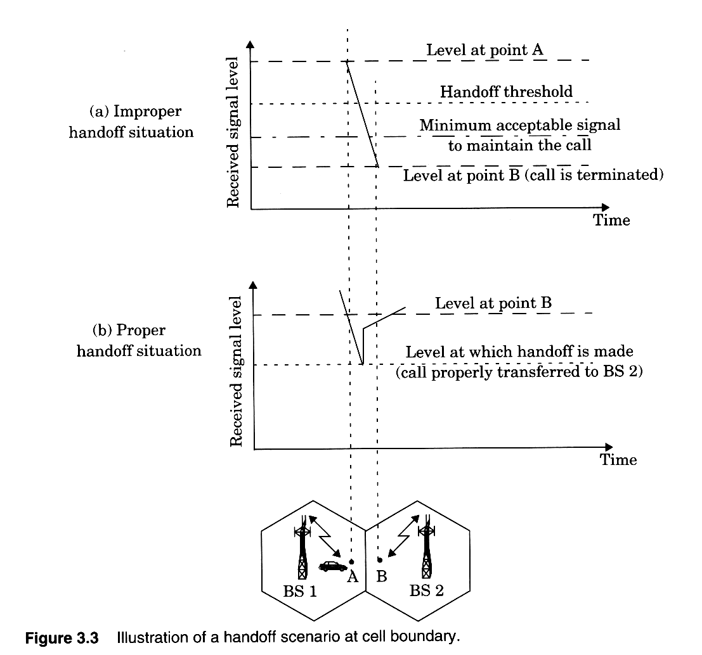
Handoff Basics

Slide 105
When to Hand off? MSC needs to ensure
When to Hand off? MSC needs to ensure:
that the power drop is not temporary: because of FADING.
that MS is actually moving away from the current BS.
MSC measures signal strength for some time (average received signal power). These calculations are performed to:
Avoid the unnecessary hand off,
Complete the necessary hand off before call drops
The time available to decide hand off depends on the subscriber’s speed.
Speed of the user can be estimated from the slope of the short term average Power. Steep curve →Quick Hand off

Slide 106
First Generation Systems
Signal Strength Measurements are made by base stations and supervised by MSC.
Each base station constantly monitors power levels of its reverse voice channels, which tells the relative location of the user.

Slide 107
Second Generation Systems: Digital TDMA
Concept of Mobile Assisted Hand Off (MAHO)
Mobile station continually measures power levels of surrounding Base Stations and reports these measurements to the serving Base Station.
MAHO method ensures faster hand off MAHO is particularly suited for Micro-Cellular Systems.

Slide 108
Inter-System Hand Off
Definition: “-----When a mobile moves from one cellular system to another, with different MSC”.
The situation occurs when
“Signal in the resident cell becomes weak, and no other cell within the system can take the call”.
Issues:
Local Call becomes long-distance call
Compatibility between two MSCs.

Slide 109
Prioritizing the Handoff
Some systems take hand off like a new call initiation
Guard Channel Concept
Reserve some channels exclusively for hand off--- do not use them for call initiation.

Slide 110
Practical Hand Off Strategies:
High Speed Vehicle VS Pedestrians
Zoning
The UMBRELLA CELL Concept: Large and Small cells are co-located. Install small antennas etc for low-speed users for proper radio coverage. This guarantees large area coverage as well.

Slide 111
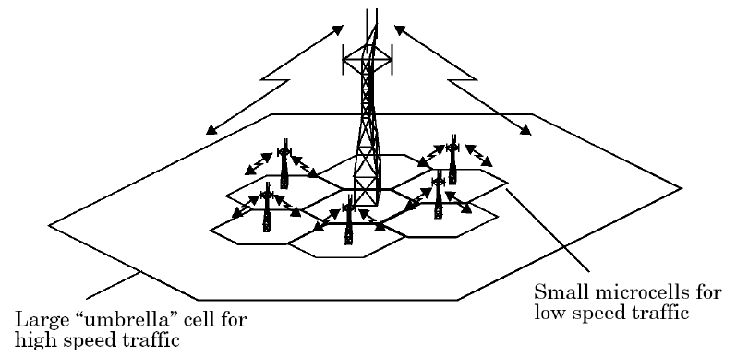
UMBRELLA Cell Approach

Slide 112
Interference and System Capacity
Creates bottleneck in increasing capacity
Sources of interference are:
Mobile Stations
Neighboring Cells
The same frequency cells
Non-cellular signals in the same spectrum
Interference in Voice Channels: Cross-Talk
Interference in Control Channels: missed/blocked calls

Slide 113
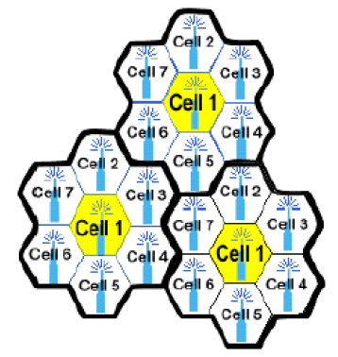
Interference and System Capacity
The yellow cells use the same set of
frequency channels, and hence, interfere
with each other
In the cellular system there are 6 first-
layer co-channels
In constant cell size and RF power, CCI is a function of Distance between the co-channel cells(D), and the size of each cell (R).
Increasing ratio D/R, CCI decreases.
Define Channel Reuse Ratio = Q = D/R
113

Slide 114
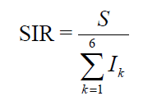

Interference and System Capacity
Signal-to-interference ratio
S is the power of the signal of interest and is the power of kth interference.
The signal strength at distance d from a source is
That is, received signal power is inversely related to nth power of the distance.
where n = path loss exponent

Slide 115
Co channel Interference
First tier cochannel Base Station
Second tier cochannel Base Station
R
D₆
D₅
D₁
D₄
Mobile Station
D₂
D₃
Serving Base Station

Slide 116
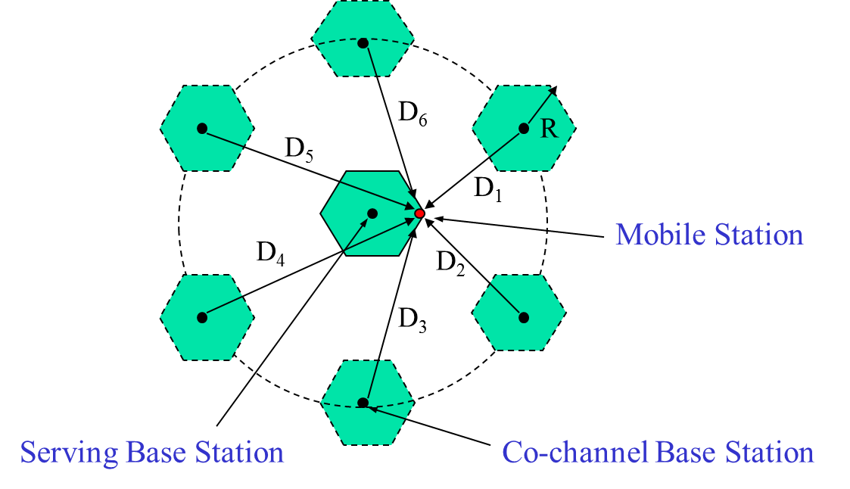
Worst Case of CCI

Slide 117
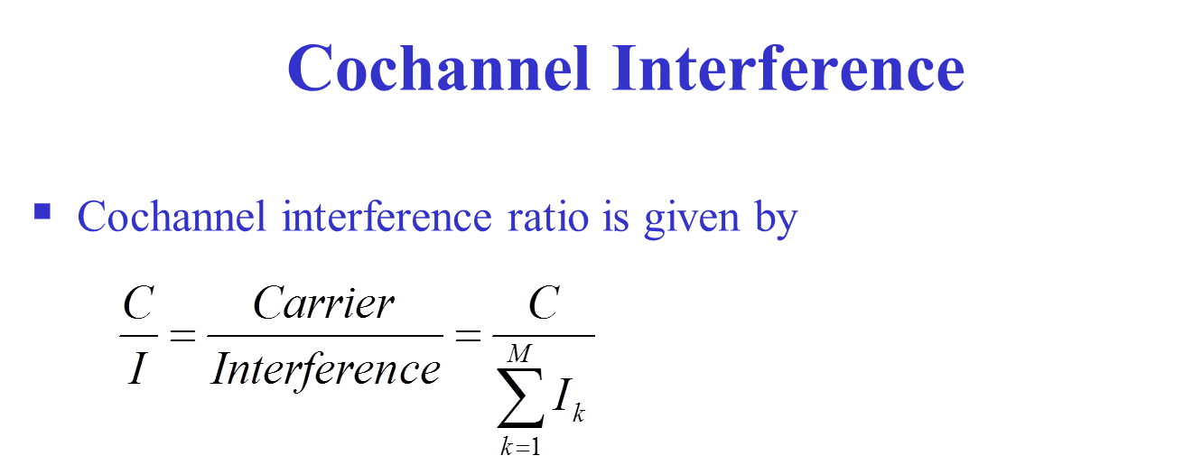

Slide 118
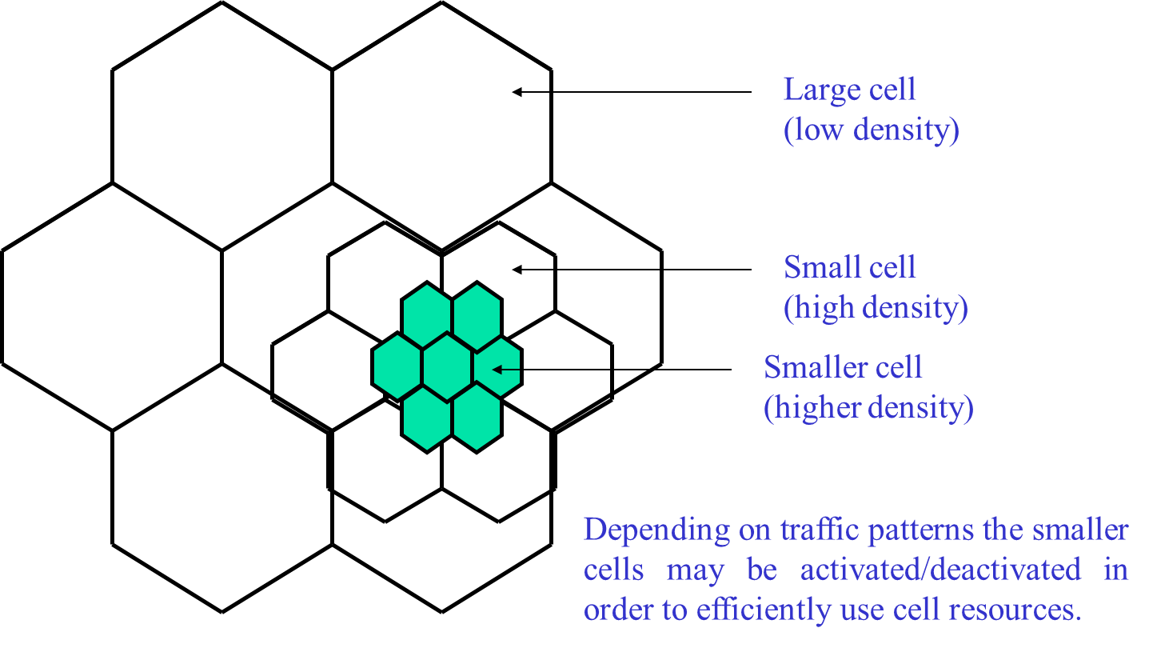
Cell Splitting

Slide 119
Cell Sectoring by Antenna Design
c
c
120º
120º
a
b
a
b
(a). Omni
(b). 120º sector
(c). 120º sector (alternate)
d
f
90º
e
60º
a
a
c
d
b
b
c
(d). 90º sector
(e). 60º sector
119

Slide 120
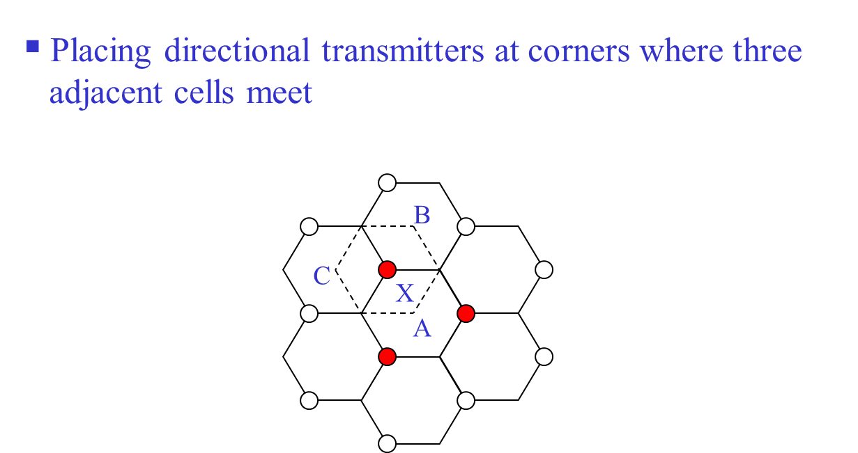
Cell Sectoring by Antenna Design

Slide 121
Trunking and Grade of Service (GOS)
Trunking
A means for providing access to users on demand from available pool of channels.
With trunking, a small number of channels can accommodate large number of random users.

Slide 122
Terminology
Traffic intensity is measured in Erlangs
One Erlang: traffic in a channel completely occupied.
0.5 Erlang: channel occupied 30 minutes in an hour.
Grade of Service (GOS): probability that a call is blocked (or delayed).
Set-Up Time: time to allocate a channel.

Slide 123
Terminology
Blocked Call: Call that cannot be completed at time of request due to congestion. Also referred to as Lost Call.
Holding Time: (H) average duration of typical call.
Load: Traffic intensity across the whole system.
Request Rate: (λ) average number of call requests per unit time.

Slide 124
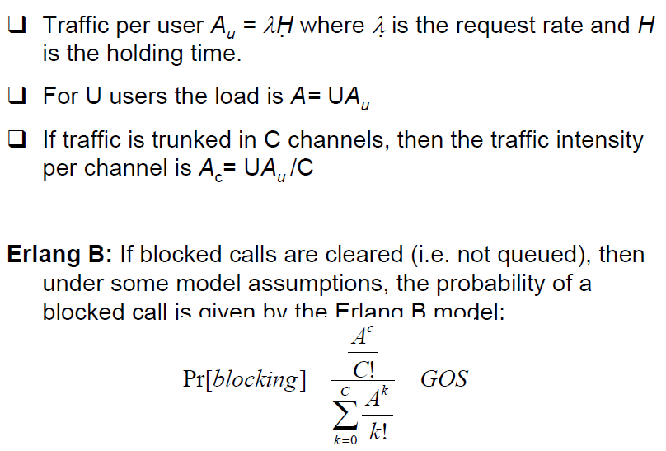
Traffic Measurements

Slide 125
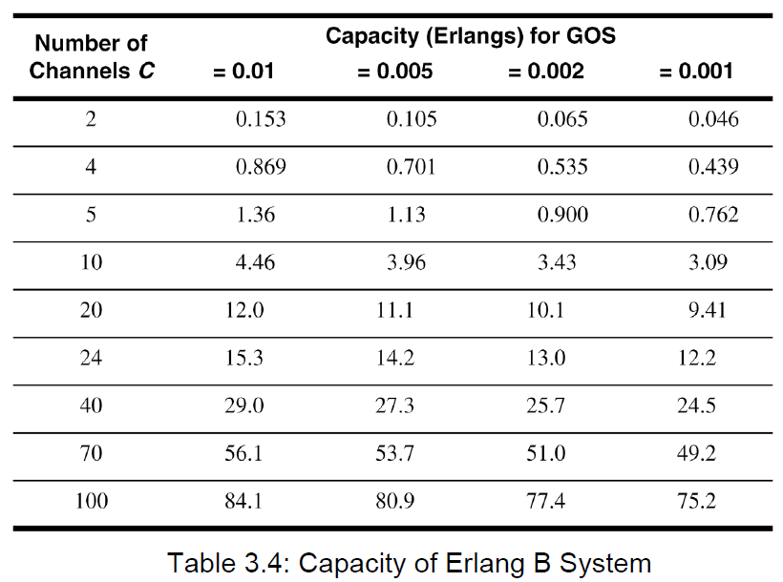
Traffic Measurements

Slide 126
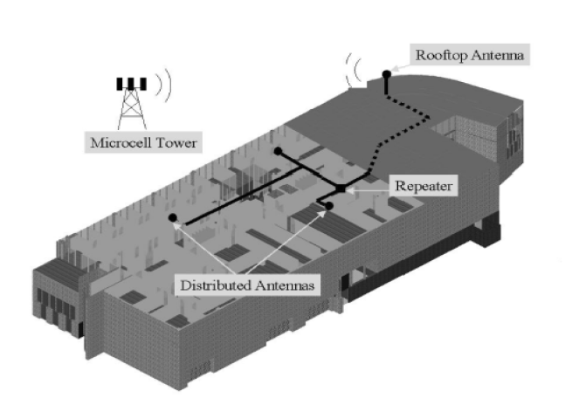
Repeaters

